Slide 1

6、Netty源码解析
THANK YOU FOR WATCHING
主讲老师Mark：446106311

Slide 2
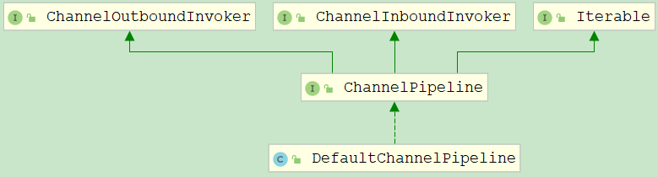
ChannelPipeline源码分析
ChannelPipeline的事件处理
构建pipeline和特性
DefaultChannelPipeline

Slide 3
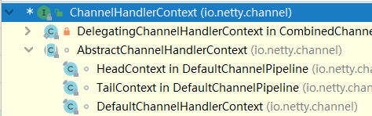
ChannelHandlerContext
AbstractChannelHandlerContext
HeadContext和TailContext
DefaultChannelHandlerContext

Slide 4
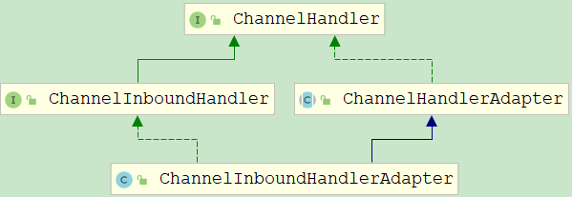
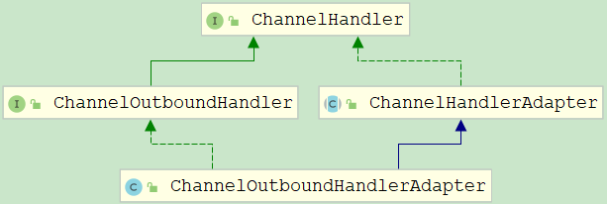
ChannelHandler
ChannelHandlerAdapter
ChannelHandler子类

Slide 5
EventLoop

Slide 6
Future和Promise源码分析

Slide 7
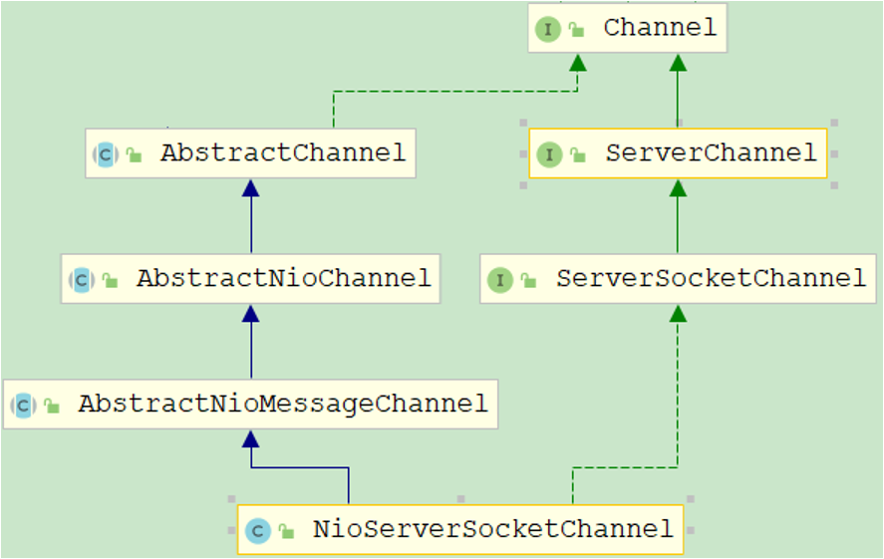
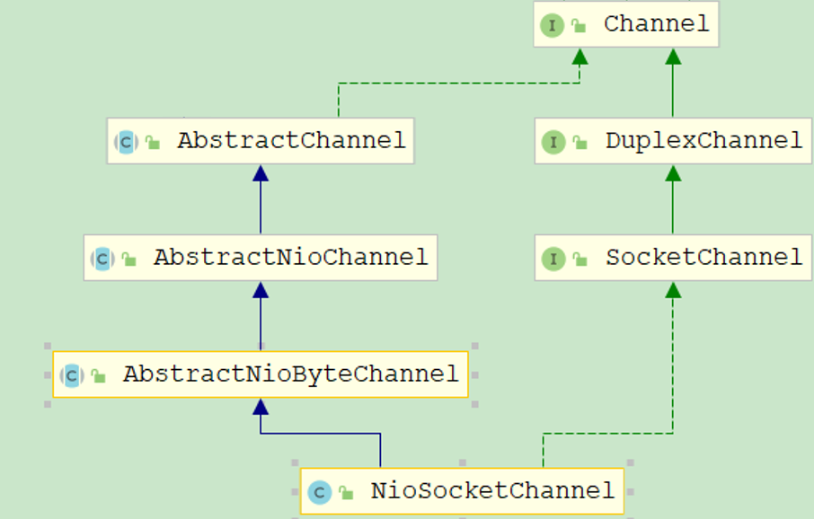
Channel系列源码分析
NioServerSocketChannel
NioSocketChannel
AbstractNioByteChannel
Channel接口
AbstractNioChannel
AbstractChannel
AbstractNioMessageChannel

Slide 8
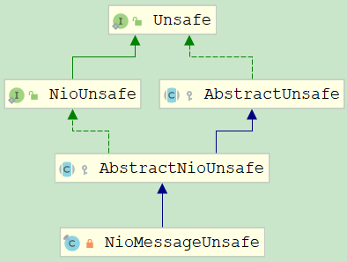
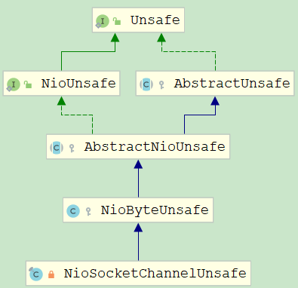
Unsafe系列
NioMessageUnsafe
NioSocketChannelUnsafe
Unsafe和NioUnsafe
AbstractUnsafe
NioByteUnsafe
AbstractNioUnsafe

Slide 9
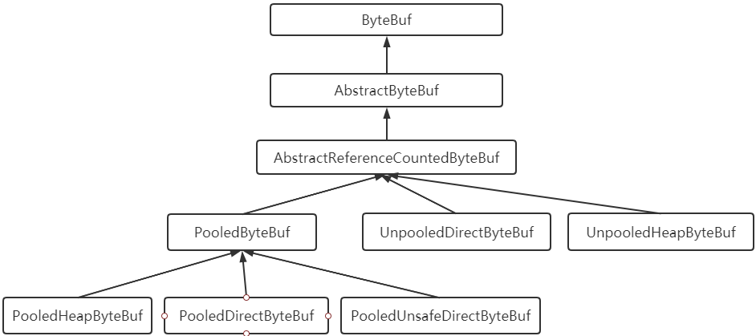
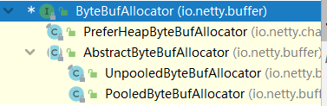
ByteBuf和ByteBufAllocator分析
ByteBuf的简介
AbstractByteBuf的源码
AbstractReferenceCountedByteBuf的源码
UnpooledHeapByteBuf
UnpooledDirectByteBuf
ByteBufAllocator的类层次关系

Slide 10
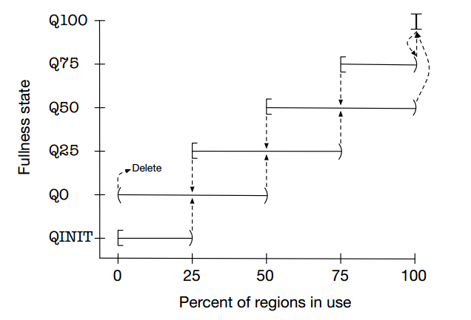
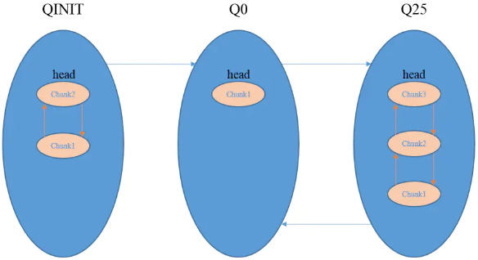
ByteBuf和ByteBufAllocator分析
PooledByteBuf
Jemalloc算法

Slide 11
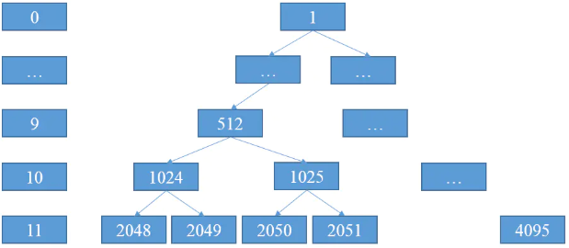
ByteBuf和ByteBufAllocator分析

Slide 12
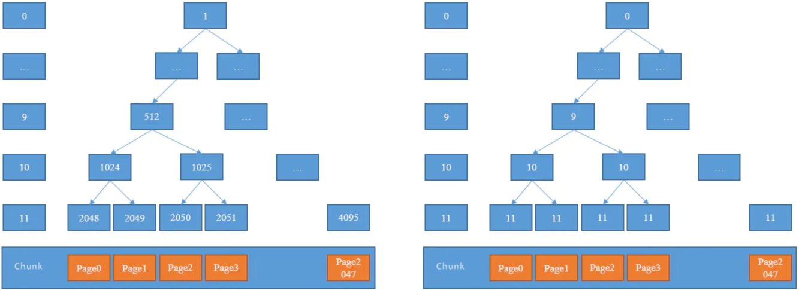
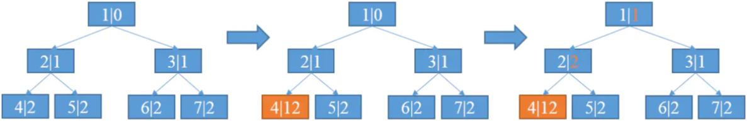
ByteBuf和ByteBufAllocator分析

Slide 13
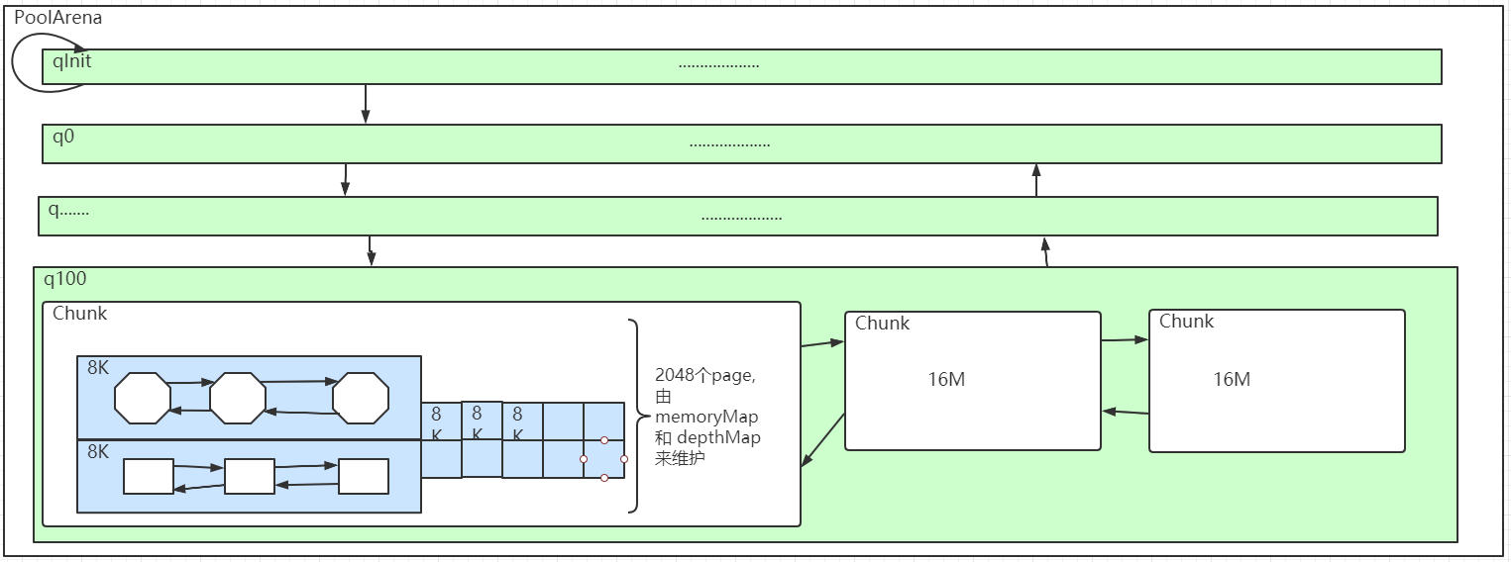

ByteBuf和ByteBufAllocator分析

Slide 14
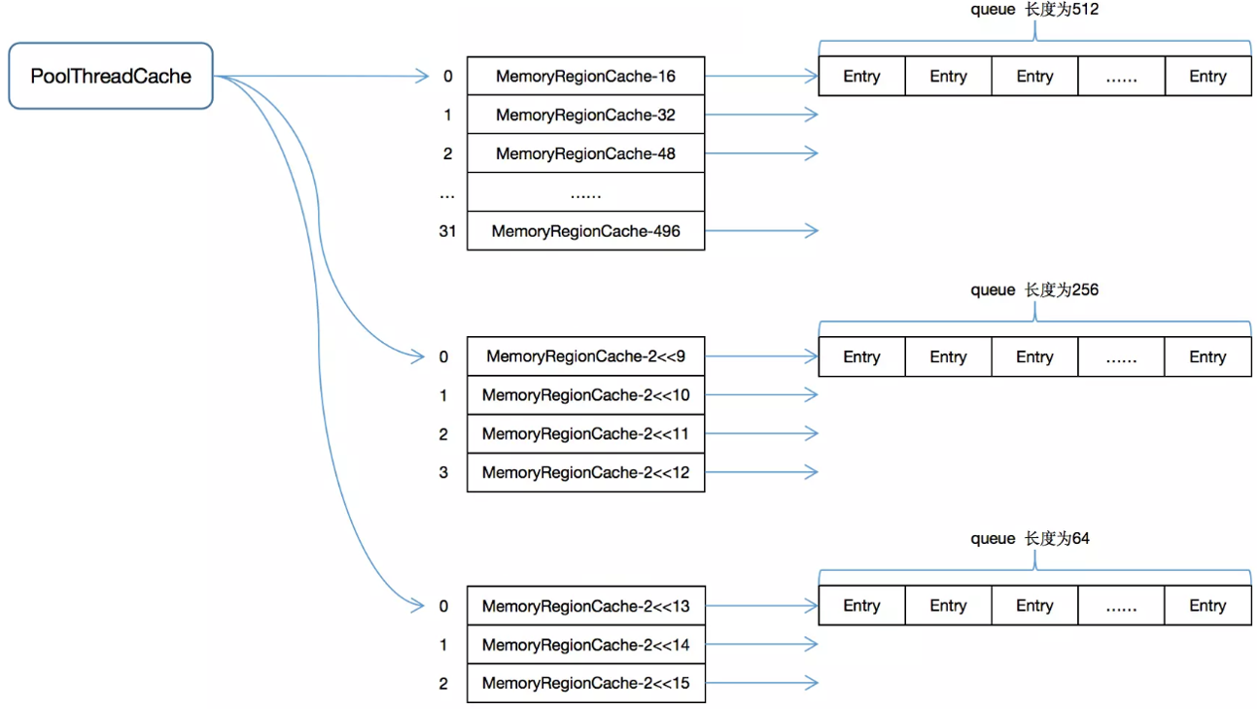
PoolThreadCache

Slide 15
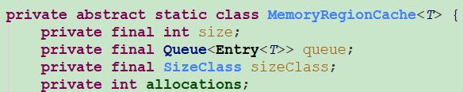
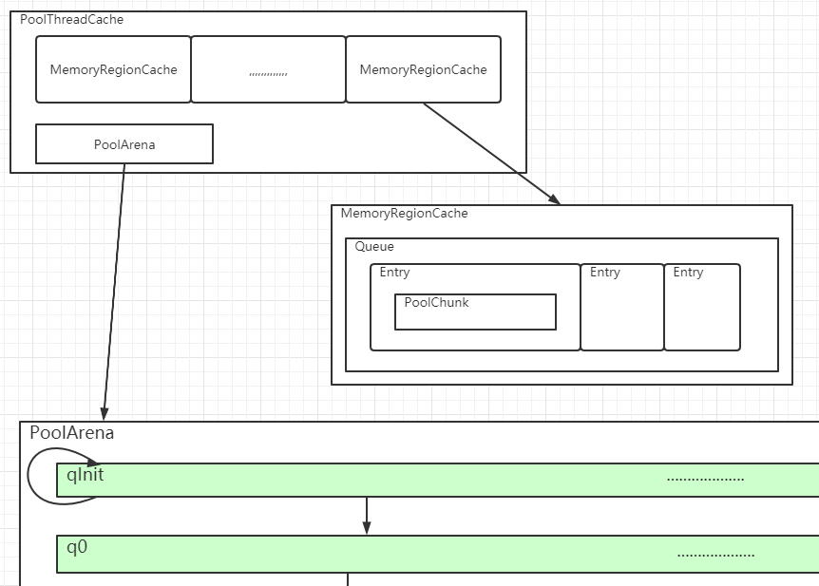

PoolThreadCache

Slide 16
服务器启动流程

Slide 17
服务端接收连接事件

Slide 18
客户端连接和连接事件

Slide 19
写数据和处理写事件

Slide 20
读事件

